Slide 1
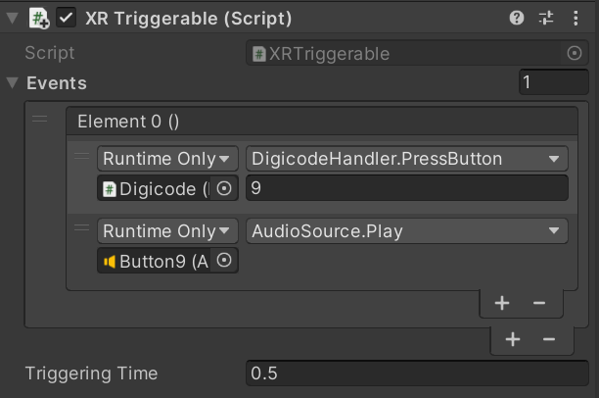
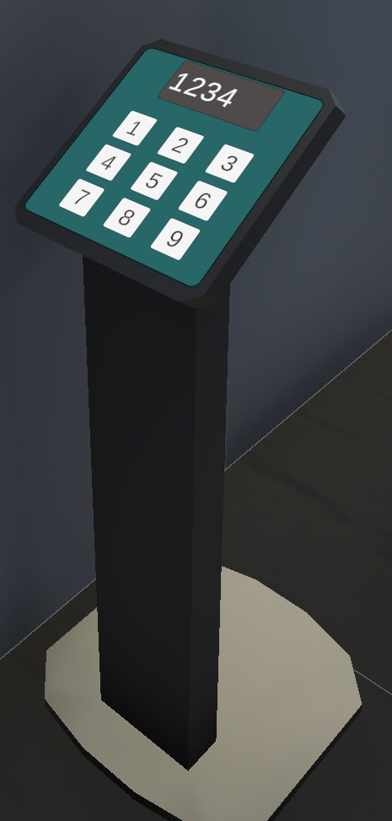
Attach Pre-defined Mono Script Component XRTriggerable to a Button

